Slide 1
ISTQB® Certified Tester – Testing with Generative AI (CT-GenAI)

Slide 2
Why ISTQB® Certified Tester – Testing with Generative AI (CT-GenAI)
https://istqb.org/istqb-certified-tester-specialist-level-testing-with-generative-ai-ct-genai-press-release/

Slide 3
Introduction – CT-GenAI Syllabus
0.1 Purpose of this Syllabus
The purpose of the CT-GenAI syllabus is to:
Provide a foundation for testers to understand Generative AI concepts.
Define the knowledge required for testing applications that use Generative AI.
Provide guidelines for training providers who prepare students for the certification.
Define the learning objectives that are tested in the exam.
The syllabus is designed for:
Test engineers
QA analysts
Automation testers
Test managers
Developers involved in AI systems
It ensures testers understand how to effectively use and test Generative AI systems.
https://istqb.org/certifications/gen-ai/

Slide 4
Introduction – CT-GenAI Syllabus
0.2 Software Testing with Generative AI
Generative AI introduces new opportunities and challenges for software testing.
Testers can use GenAI to support many testing activities:
Applications in Testing
Generating test cases
Creating test data
Writing automation scripts
Analyzing requirements
Detecting defects
Generating documentation

Slide 5
Introduction – CT-GenAI Syllabus
Challenges faced when using Generative AI
GenAI systems can produce:
Hallucinations (incorrect answers)
Unpredictable outputs
Security and privacy risks
Therefore, testers must validate and verify GenAI outputs carefully.

Slide 6
Introduction – CT-GenAI Syllabus
0.3 Career Path for Testers
The CT-GenAI certification is part of the ISTQB Certified Tester certification scheme.
Typical testing career path:
Foundation Level (CTFL) Basic testing concepts.
Specialist / Advanced Certifications Examples:
Test Automation Engineer
Performance Testing
Security Testing
Testing with Generative AI (CT-GenAI)
Expert Level Advanced testing leadership roles.
The CT-GenAI certification helps testers develop skills needed for AI-driven testing environments.

Slide 7
Introduction – CT-GenAI Syllabus
Prerequisite Requirement
To register for the CT-GenAI certification:
You must already have the ISTQB® Certified Tester Foundation Level (CTFL) certificate.
CT-GenAI is a specialist-level certification that builds on the Foundation Level knowledge of software testing.

Slide 8
Introduction – CT-GenAI Syllabus
0.4 Business Outcomes
After completing this certification, professionals should be able to:
Understand Generative AI
Explain the basics of Generative AI and Large Language Models (LLMs).
Use GenAI in Testing
Apply prompt engineering techniques.
Generate test cases using AI.
Support test automation using GenAI tools.
Manage AI Risks
Identify risks like:
Improve Testing Efficiency
Organizations benefit through:
Faster test case creation and defect detection
Improved test coverage
Reduced manual effort

Slide 9
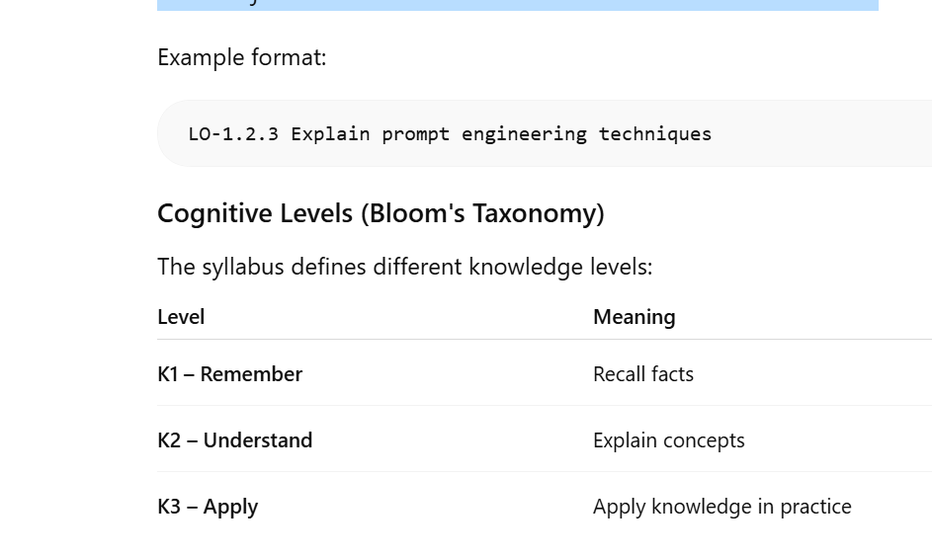
Introduction – CT-GenAI Syllabus
0.5 Examinable Learning Objectives, Hands-on Objectives and Cognitive Level of Knowledge
Each section of the syllabus contains learning objectives (LOs).
These objectives describe what candidates must know for the exam.

Slide 10
Introduction – CT-GenAI Syllabus
Example:
K1 → Define Generative AI
K2 → Explain hallucinations
K3 → Apply prompt engineering to create test cases
Hands-on objectives are practical exercises recommended for training but not tested directly in the exam.
The specific hands-on objectives (HO) are shown at the beginning of each chapter. Each HO is linked to a LO at level K2 or K3, with the aim of refining learning through hands-on practice.
The level of a HO is classified as follows:
• H0: This can include a live demo of an exercise or recorded video. Since this is not performed by the trainee, it is not strictly an exercise.
• H1: Guided exercise. The trainees follow a sequence of steps performed by the trainer.
• H2: Exercise with hints. The trainee is given an exercise with relevant hints to enable the exercise to be solved within the given timeframe.

Slide 11
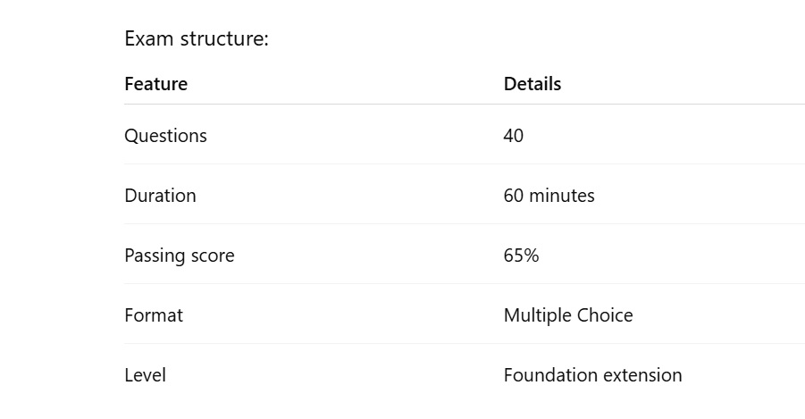
Introduction – CT-GenAI Syllabus
0.6 The Certified Tester Testing with Generative AI Certificate Exam

Slide 12
Introduction – CT-GenAI Syllabus
0.7 Accreditation
Training providers offering CT-GenAI courses must be accredited by ISTQB member boards.
Accreditation ensures:
Training follows the official syllabus
Trainers meet quality standards
Course materials align with the learning objectives
Examples of member boards:
ASTQB
BCS
iSQI

Slide 13
Introduction – CT-GenAI Syllabus
0.8 Handling of Standards
The syllabus references existing international standards when relevant.
Examples may include:
ISO software quality standards
AI governance frameworks
security and privacy guidelines
However, the syllabus focuses on testing practices rather than deep standard specifications.

Slide 14
Introduction – CT-GenAI Syllabus
0.9 Level of Detail
The syllabus defines exact depth of knowledge required for the exam.
Key characteristics:
Focus on practical understanding
Avoids unnecessary theoretical complexity
Emphasizes concepts relevant to testers
Candidates are expected to understand:
How Generative AI works
How testers can use it
Risks associated with AI systems

Slide 15
Introduction – CT-GenAI Syllabus
0.10 How this Syllabus is Organized
The CT-GenAI syllabus is structured into several chapters:
Introduction to Generative AI for Testing
Prompt Engineering for Testing
Managing Risks of Generative AI
LLM-Powered Test Infrastructure
Operationalizing Generative AI (LLMOps)
Adoption of Generative AI in Organizations
Each chapter includes:
Learning objectives
Key concepts
Examinable material

Slide 16
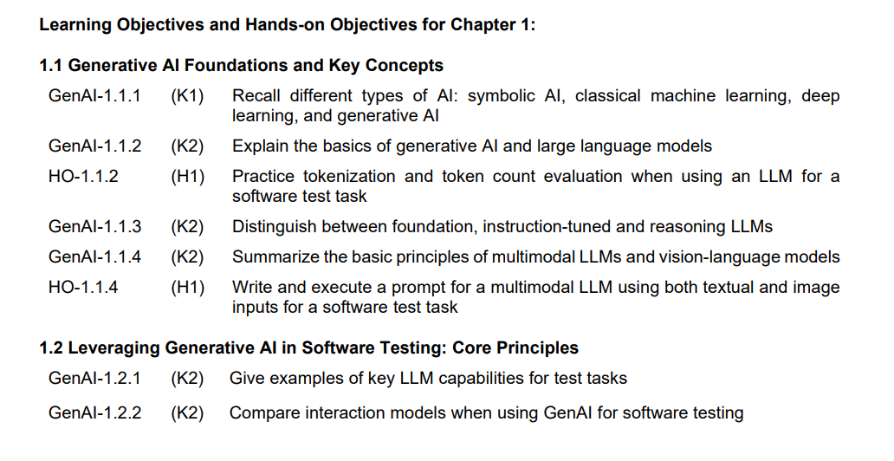
Chapter 1 1.Introduction to Generative AI for Software Testing

Slide 17
Chapter 1
1.1 Generative AI Foundations and Key Concepts
1.1.1 AI Spectrum: Symbolic AI, Classical Machine Learning, Deep Learning, and Generative AI
1.1.2 Basics of Generative AI and LLMs
1.1.3 Foundation, Instruction-Tuned and Reasoning LLMs
1.1.4 Multimodal LLMs and Vision-Language Models
1.2 Leveraging Generative AI in Software Testing: Core Principles
1.2.1 Key LLM Capabilities for Test Tasks
1.2.2 AI Chatbots and LLM-Powered Testing Applications for Software Testing

Slide 18
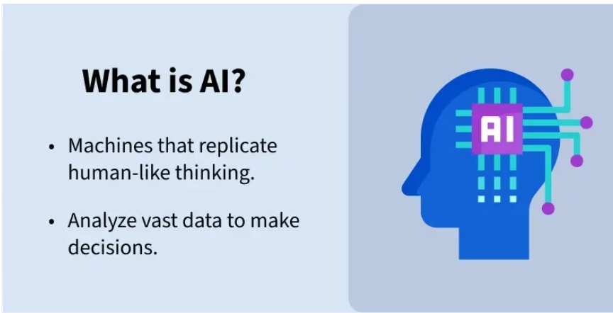
1.1 Generative AI Foundations and Key Concepts
What is AI and Types of AI
Artificial Intelligence (AI) is a branch of computer science that focuses on building machines or software that can perform tasks that normally require human intelligence.
These tasks include:
Learning from data
Understanding language
Recognizing images and speech
Making decisions
Solving problems
AI is the ability of a computer or machine to mimic human intelligence.

Slide 19
1.1 Generative AI Foundations and Key Concepts
Examples of AI
Voice assistants (Alexa, Google Assistant)
Recommendation systems (YouTube, Netflix)
Self-driving cars
Chatbots
Face recognition systems

Slide 20
1.1 Generative AI Foundations and Key Concepts
What is AI and Types of AI
Types of Artificial Intelligence
Based on Capabilities
Based on Functionality

Slide 21
1.1 Generative AI Foundations and Key Concepts
Types of Artificial Intelligence
Based on Capabilities
1.1 Narrow AI (Weak AI)
Narrow AI is designed to perform a specific task only.
Key Characteristics
Specialized in one domain
Cannot perform tasks outside its training
Most AI systems today fall into this category
Examples
Google Assistant
Siri
ChatGPT
Recommendation systems (Netflix, Amazon)
Explanation
Even though systems like ChatGPT feel intelligent, they do not possess true understanding or general reasoning across all domains.

Slide 22
1.1 Generative AI Foundations and Key Concepts
Types of Artificial Intelligence
Based on Capabilities
1.2 General AI (Strong AI / AGI)
General AI refers to machines that can perform any intellectual task that a human can do.
Key Characteristics
Human-level intelligence
Can reason, learn, and adapt across multiple domains
Can transfer knowledge between tasks
Current Status
Not yet achieved
Still a major research goal
Example (Hypothetical)
A robot that can:
Learn math
Drive a car
Write code
Understand emotions

Slide 23
1.1 Generative AI Foundations and Key Concepts
Types of Artificial Intelligence
Based on Capabilities
1.3 Super AI
Super AI is a level beyond human intelligence.
Key Characteristics
Surpasses human intelligence in all aspects:
Creativity
Decision-making
Emotional intelligence
Can improve itself (self-evolving systems)
Current Status
Purely theoretical
Often discussed in future AI and ethics debates

Slide 24
1.1 Generative AI Foundations and Key Concepts
Types of Artificial Intelligence
Based on functionality
2.1 Reactive Machines
These AI systems do not have memory and only respond to current inputs.
Key Characteristics
No learning from past experiences
Works only on present data
Very basic AI
Example
IBM Deep Blue
Explanation
Deep Blue defeated Garry Kasparov but:
It could not learn from past games
It only evaluated current board positions

Slide 25
1.1 Generative AI Foundations and Key Concepts
Types of Artificial Intelligence
Based on functionality
2.2 Limited Memory
These systems can use past data to improve decisions.
Key Characteristics
Learns from historical data
Temporary memory
Most modern AI systems belong here
Examples
Self-driving cars
Recommendation systems
Chatbots
Explanation
A self-driving car:
Remembers speed, distance, surroundings
Uses past data to make better driving decisions

Slide 26
1.1 Generative AI Foundations and Key Concepts
Types of Artificial Intelligence
Based on functionality
2.3 Theory of Mind AI
This type of AI can understand emotions, beliefs, and intentions of others.
Key Characteristics
Understands human emotions
Can interact socially
Adapts behavior based on others
Current Status
Still in research phase
Not fully developed

Slide 27
1.1 Generative AI Foundations and Key Concepts
Based on Capabilities
Narrow AI → Task-specific (existing)
General AI → Human-level (future)
Super AI → Beyond human (theoretical)
Based on Functionality
Reactive Machines → No memory
Limited Memory → Uses past data (current AI)
Theory of Mind → Understands emotions (research)
Self-Aware AI → Conscious machines (future)

Slide 28
1.1.1 - AI Spectrum: Symbolic AI, Classical Machine Learning, Deep Learning, and Generative AI
Artificial Intelligence (AI) is a broad field that encompasses different types of technologies, each with its own unique way of solving problems
Some of the AI technologies discussed in Gen AI ISTQB are:
1.Symbolic AI
2. Classic Machine learning
3.Deep learning
4.Generative AI

Slide 29
1.1.1 - Symbolic AI
Symbolic AI uses a rule-based system to mimic human decision-making. Essentially, symbolic AI represents knowledge using symbols and logical rules.
Symbolic AI is one of the earliest approaches to artificial intelligence where knowledge is represented using symbols, rules, and logic created by humans.
In symbolic AI, computers solve problems using:
Rules
Logic and relationships
Knowledge representations
Reasoning systems
Simple definition:
Symbolic AI = AI that works using human-defined rules and logical reasoning.
Example rule:
IF temperature > 38°C THEN patient_has_fever = TRUE
The system evaluates rules like this to make decisions.

Slide 30
1.1.1 - Symbolic AI
Why it is called “Symbolic” AI
It is called symbolic because knowledge is represented using symbols that represent real-world objects or concepts.
Symbol Meaning
Fever Patient temperature above threshold
Rain Weather condition
Wet_ground Result of rain
Example relationship:
Rain → Wet_ground
The AI uses these symbols and relationships to perform reasoning.

Slide 31
1.1.1 - Symbolic AI
Example of Symbolic AI System
Expert systems are the most famous symbolic AI systems.
They mimic human expert decision-making.
Example: Medical diagnosis system.
Rules:
IF fever AND cough THEN possible disease = flu
Input:
fever = TRUE cough = TRUE
Output:
Diagnosis = Flu

Slide 32
1.1.1 - Symbolic AI
Types of Symbolic AI
1. Rule-Based Systems (Expert Systems)
Rule-based systems use IF–THEN rules to make decisions.
A knowledge base stores rules, and an inference engine applies those rules to solve problems.
Example:
IF patient has fever AND cough THEN possible disease = flu
Applications
Medical diagnosis
Financial decision systems
Customer support systems
A famous example of an early expert system was MYCIN.
Limitations of Symbolic AI
Cannot learn from data
All knowledge must be manually programmed.

Slide 33
1.1.1 - Types of Symbolic AI
2.Logic-Based AI
Logic-based AI uses mathematical logic to represent knowledge and perform reasoning.
It often uses predicate logic or first-order logic.
Example:
All humans are mortal Socrates is a human Therefore, Socrates is mortal
The AI uses logical rules to infer new information.
A programming language commonly used for logic-based AI is Prolog.
Applications
Automated theorem proving
Knowledge reasoning systems
Natural language understanding (early systems)

Slide 34
1.1.1 - Types of Symbolic AI
3.Knowledge Representation Systems
These systems store knowledge in structured formats so computers can understand relationships between concepts.
Common representations include:
Semantic Networks
Information is represented as nodes and relationships.
Example:
Dog → is a → Animal Dog → has → Tail
Frames
Frames store knowledge in structured objects with attributes.
Example:
Frame: Car Attributes: Wheels = 4 Engine = Yes Fuel = Petrol/Diesel
Applications
Knowledge graphs
Intelligent databases
Semantic web systems

Slide 35
1.1.1 - Types of Symbolic AI
4. Planning Systems
Planning systems help AI plan sequences of actions to achieve goals.
Example:
Goal: Make tea
Steps:
Boil water
Add tea leaves
Pour into cup
The AI decides the best sequence of actions to reach a goal.
Applications
Robotics
Logistics planning
Automated decision systems

Slide 36
1.1.1 - Types of Symbolic AI
5.Search-Based AI
Search-based AI finds solutions by exploring possible states and paths.
Example problems:
Maze solving
Chess playing
Pathfinding
Algorithms used include:
Breadth-First Search (BFS)
Depth-First Search (DFS)
A* Search
A famous symbolic AI example is Deep Blue, which defeated world champion Garry Kasparov in 1997.

Slide 37
1.1.1 - Symbolic AI
Advantages of Symbolic AI
Provides clear and explainable decision-making.
Easy to understand and interpret by humans.
Strong in logical reasoning and rule-based problem solving.
Requires very little data to operate.
Produces consistent and predictable results.
Easy to modify by updating rules.

Slide 38
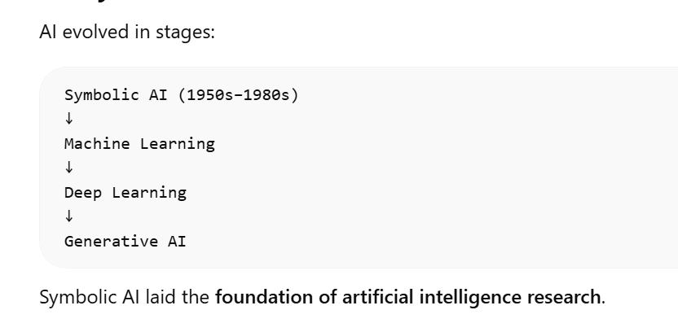
1.1.1 - Symbolic AI
Limitations of Symbolic AI
Cannot learn from data
All knowledge must be manually programmed.
It struggles with vague or incomplete data.
Writing rules manually for complex systems becomes difficult.

Slide 39
1.1.1 - Classical Machine Learning
Classical machine learning is a data-driven approach that requires data preparation, feature selection and model training, and can be used for tasks such as defect categorization and predicting software problems.
Classical Machine Learning (ML) is a type of artificial intelligence where computers learn patterns from data instead of being explicitly programmed with rules.
In Symbolic AI, humans write rules. In Machine Learning, the system learns the rules automatically from data.
Simple definition:
Classical Machine Learning = Algorithms that learn patterns from data to make predictions or decisions.
Example: Predict whether an email is spam or not spam based on previous email data.

Slide 40
1.1.1 - Classical Machine Learning
Machine learning works using three main components:
Data → Algorithm → Model → Prediction
Explanation:
Data Historical examples used for training.
Algorithm Mathematical method used to learn patterns.
Model The trained system that makes predictions.
Prediction Output generated by the model.
Example:
Training Data: house size, location, price ↓ Model learns relationship ↓ Predict price of new house

Slide 41
1.1.1 - Types of Classical Machine Learning
Example Applications
Spam detection
Credit risk prediction
Medical diagnosis
Fraud detection
1. Supervised Learning
In supervised learning, the model learns using labeled data.
Labeled data means input + correct output.
Example dataset:
House Size Price
1000 sq ft 50,000
Common Algorithms
Linear Regression
Logistic Regression
Decision Trees
Support Vector M
Example:
Input: Email text Output: Spam or Not Spam

Slide 42
1.1.1 - Types of Classical Machine Learning
Common Algorithms
K-Means Clustering
Hierarchical Clustering
DBSCAN
Principal Component Analysis (PCA)
Example Applications
Customer segmentation
Market analysis
Pattern discovery
Example result:
Group 1: Young customers Group 2: High spending customers
2. Unsupervised Learning
In unsupervised learning, the data does not contain labels.
The algorithm tries to discover patterns or structures in the data.
Example dataset:
Customer ID Age Purchase Amount
1 22 500
2 45 2000
3 21 450
The model groups customers with similar behavior.

Slide 43
1.1.1 - Types of Classical Machine Learning
3. Reinforcement Learning
In reinforcement learning, the model learns by interacting with an environment and receiving rewards or penalties.
Example:
Action → Reward or Penalty
The goal is to maximize rewards over time.
Example applications:
Self-driving cars
Game-playing AI (Chess, Go)
Robotics
Example:
Move in game → reward Bad move → penalty
The AI gradually learns the best strategy.

Slide 44
1.1.1 - Advantages of Classical Machine Learning
Learns from data
The system improves as more data becomes available.
Handles complex relationships
ML can detect patterns humans may miss.
Useful for predictive tasks
Examples:
Sales forecasting
Risk prediction
Recommendation systems

Slide 45
1.1.1 - Limitations of Classical Machine Learning
Requires feature engineering
Humans must manually select useful features.
Limited performance on unstructured data
Classical ML struggles with:
Images
Speech
Natural language
These tasks are better handled by deep learning.
Requires good quality data
Poor data leads to poor models.

Slide 46
1.1.1 - Deep Learning
Deep learning uses machine learning structures called neural networks to automatically learn features from data.
Deep learning models can find patterns in very large and complex datasets, such as images, video, audio, or text, without the need for users to manually define features, though in practice, it may still require human involvement in tasks such as data annotation, model tuning, or result validation.
Deep Learning is a type of Artificial Intelligence (AI) that allows computers to learn from large amounts of data using neural networks, similar to how the human brain processes information.
It is a subset of Machine Learning, which itself is part of AI.
The hierarchy looks like this:
Artificial Intelligence (AI) ↓ Machine Learning (ML) ↓ Deep Learning (DL)
Deep learning uses artificial neural networks with many layers to automatically learn complex patterns from data.

Slide 47
1.1.1 - Deep Learning
What are Neural Networks?
Deep learning uses Artificial Neural Networks (ANNs).
They are inspired by neurons in the human brain.
Each neuron:
Receives input
Processes the input
Sends output to the next neuron
Simple representation:
Input → Neuron → Neuron → Output
Thousands or millions of neurons work together in a deep learning model.

Slide 48
1.1.1 - Deep Learning
Understanding with a Simple Example
Imagine teaching a computer to recognize a cat in an image.
A deep learning model learns step-by-step:
Layer 1: Detects simple features
edges
lines
Layer 2: Detects shapes
ears
eyes
Layer 3: Detects objects
face
body
Final Layer: Recognizes
This is a CAT
So deep learning builds understanding layer by layer.

Slide 49
1.1.1 -Types of Deep Learning Networks
1. Convolutional Neural Networks (CNN)
Used for image processing.
Applications:
Face recognition
Medical imaging
Self-driving cars
2. Recurrent Neural Networks (RNN)
Used for sequence data like text or speech.
Applications:
Language translation
Speech recognition
3. Transformers
Used in modern AI systems and Large Language Models.
They power tools like:
ChatGPT
Gemini
Transformers are very powerful for text understanding and generation.

Slide 50
1.1.1 - Deep Learning
Applications of Deep Learning
Deep learning is used in many real-world systems.
Image Recognition
Example:
Face unlock in smartphones
Advantages of Deep Learning
Learns Automatically
Does not require manually written rules.
High Accuracy
Performs very well with large datasets.
Handles Complex Problems
Good for images, speech, and language.
Limitations of Deep Learning
Needs Large Data
Deep learning models require huge datasets.
Requires High Computing Power
Training often needs GPUs or specialized hardware.

Slide 51
1.1.1 - What is Generative AI
Generative AI is a type of artificial intelligence that creates new content based on patterns learned from data.
Examples of generated content:
Text
Code
Images
Audio
Examples of GenAI tools:
ChatGPT
GitHub Copilot
Bard/Gemini
It does this by learning patterns from large datasets and then using those patterns to produce new content that looks similar to what humans create.

Slide 52
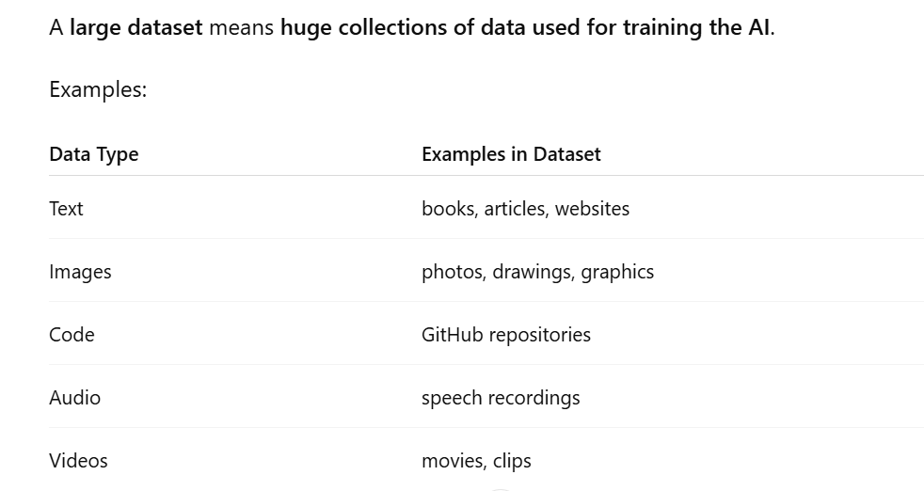
1.1.1 - What is Generative AI
Some models are trained on billions or trillions of words.

Slide 53
1.1.1 - What is Generative AI
Understanding with a Simple Human Example
Imagine a child learning language.
A child hears sentences like:
“I am going to school.”
“She is eating food.”
“They are playing cricket.”
After hearing thousands of sentences, the child begins to recognize patterns such as:
Subject → Verb → Object
“is/are” used with actions
Certain words appear together frequently
Eventually the child can create new sentences that they have never heard before.
Example:
“I am playing football.”
The child learned the pattern of sentence structure, not just memorized sentences.
Generative AI works in a similar way.

Slide 54
1.1.1 - What is Generative AI
Example with Text Data
Suppose the AI is trained on millions of sentences like:
“The sky is blue.”
“The grass is green.”
“Snow is white.”
The AI learns patterns such as:
Sentence structure: Subject + is + description
Certain objects are often associated with specific words.
So if you give the prompt:
The sky is
The AI predicts the most likely next word based on patterns it learned:
blue

Slide 55
1.1.1 - What is Generative AI
Example with Programming Code
If an AI sees millions of Python programs, it learns patterns like:
Common pattern for loops:
for i in range(10): print(i)
Common pattern for functions:
def add(a, b): return a + b
When a developer writes:
write a python function to add two numbers
The AI generates code because it has learned the structure of Python programs.

Slide 56
1.1.1 - What is Generative AI
Key note
AI studies huge amounts of data.
It identifies relationships and structures in the data.
It learns how information usually appears together.
It uses those patterns to generate new content.

Slide 57
1.1.1 - What is Generative AI
Types of Generative AI
Text Generation
Generates human-like text.
Examples:
Chatbots
Essay writing
Summaries
Tools:
ChatGPT
Claude

Slide 58
1.1.1 - What is Generative AI
Image Generation
Creates images from text descriptions.
Example prompt:
A futuristic city at sunset
Tools:
DALL·E
Midjourney
Code Generation
Generates programming code automatically.
Example prompt:
Write a Python function to add two numbers
Tools:
GitHub Copilot

Slide 59
1.1.1 - What is Generative AI
Audio and Video Generation
Generates:
Music
Voice
Videos
Animations
Applications of Generative AI
Generative AI is used in many industries.
Software Development
Code generation
Bug fixing
Documentation
Example: GitHub Copilot

Slide 60
1.1.1 - What is Generative AI
Advantages of Generative AI
Faster Content Creation
Generates text, images, or code in seconds.
Increased Productivity
Helps developers, designers, and writers work faster.
Creativity Support
Can generate ideas and creative content.
Limitations of Generative AI
Hallucination
AI sometimes produces incorrect or fabricated information.
Bias
If training data is biased, the output may also be biased.
Lack of True Understanding
Generative AI predicts patterns but does not truly understand meaning like humans.

Slide 61
1.1.1 - Key Concepts in GenAI
1.Tokenization
2.Pattern Learning
3. Predicting the Next Token
4. Context Window
5. Multimodal models

Slide 62
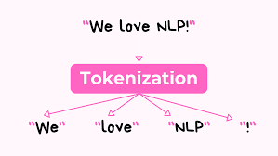
1.1.1 - Tokenization
Text is broken into tokens (small pieces of words).
Tokenization is the process of breaking text into smaller pieces called tokens so that a computer or AI model can process and understand the text efficiently.
A token can be:
A word
A part of a word
A character
A punctuation symbol
AI models like Large Language Models (LLMs) do not read text like humans. Instead, they convert text into tokens, which makes it easier for the model to analyze patterns and generate responses.

Slide 63
1.1.1 - Tokenization
Example of Tokenization
Original Sentence
"Artificial Intelligence is powerful."
After Tokenization (word level)
["Artificial", "Intelligence", "is", "powerful", "."]
Subword Tokenization Example
["Artificial", "Intelli", "gence", "is", "power", "ful"]
Here, words may be split into smaller parts so the model can understand new words it has not seen before.

Slide 64
1.1.1 - Why Tokenization is important
Converts raw text into smaller units (tokens) that models can process.
Enables machines to understand and analyze human language.
Standardizes text for consistent processing.
Helps in handling punctuation, spaces, and special characters.
Improves efficiency of NLP models.

Slide 65
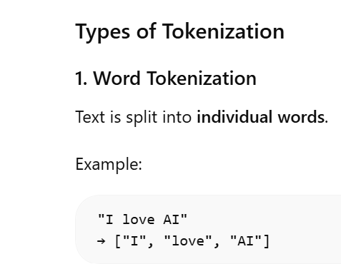
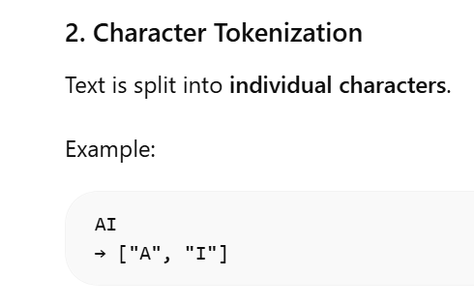
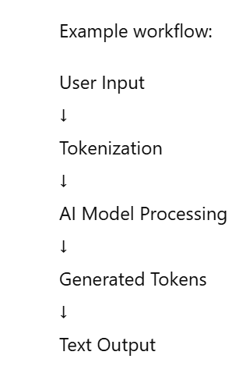
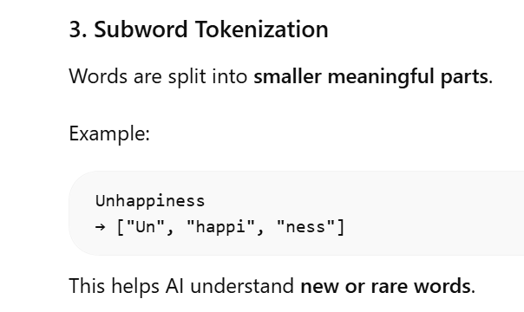
1.1.1 - Types of Tokenization

Slide 66
1.1.1 -Pattern Learning
What Pattern Learning Means
Instead of being explicitly programmed with rules (like in symbolic AI), a machine:
Observes data
Identifies similarities and regularities
Learns from those patterns
Applies the learned knowledge to unseen situations
In simple terms, it’s how machines “learn from examples.”

Slide 67
1.1.1 -Pattern Learning
Examples of Pattern Learning
1. Spam Detection
Learns patterns in spam emails (keywords, structure)
Predicts whether a new email is spam
2. Image Recognition
Learns patterns like shapes, edges, colors
Identifies objects (cats, cars, etc.)
3. Recommendation Systems
Learns user behavior patterns
Suggests products or movies

Slide 68
1.1.1 -Predicting the Next Token
Predicting the Next Token is a core concept in modern AI language models where the system predicts the most likely next word (or part of a word) in a sequence based on the context of previous words.

Slide 69
1.1.1 -Predicting the Next Token
How It Works
Input Sentence (Context) Example: “I am going to the”
Model Analysis The model looks at patterns it has learned from massive text data.
Probability Assignment It assigns probabilities to possible next tokens:
school → 40%
market → 25%
gym → 15%
park → 10%
Prediction It selects the most likely (or samples one): → “school”

Slide 70
1.1.1 - Context Window
Context Window refers to the maximum amount of text (tokens) an AI model can consider at one time while generating a response.
In simple terms, it is the memory space of the AI model during a conversation or task.
Large Language Models (LLMs) read input as tokens, and the context window defines how many tokens the model can process together to understand the context and generate relevant output.

Slide 71
1.1.1 - Context Window
Simple Example
Suppose a model has a context window of 1000 tokens.
That means the model can only consider 1000 tokens at once, which may include:
User input
Previous conversation
System instructions
Generated output
If the conversation exceeds this limit, older tokens are removed from the context.

Slide 72
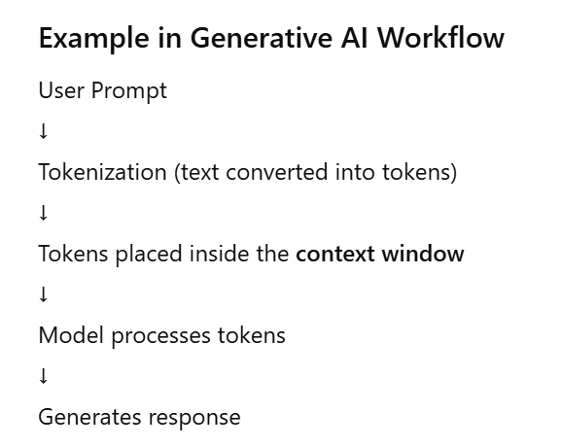
1.1.1 - Context Window

Slide 73
1.1.1 - Context Window
Example in Chatbots
If you ask:
“Explain AI.”
“Now explain machine learning.”
“How are they different?”
The AI uses the context window to remember earlier questions and provide a relevant answer.
If the conversation becomes very long and exceeds the context limit, the AI may forget earlier parts.

Slide 74
1.1.1 - Context Window
Why Context Window is Important
1. How much information the AI remembers
A larger context window allows the AI to remember more conversation history or document content.
2. Quality of responses
More context helps the AI generate more accurate and relevant responses.
3. Handling long documents
Models with larger context windows can analyze long articles, reports, or code files.

Slide 75
1.1.1 - Multimodal models
Multimodal models are AI systems that can process, understand, and generate information from multiple types of data (modalities) at the same time.
A modality refers to a type of input or data format.
Examples of modalities:
Text
Images
Audio
Video
Sensor data
So a multimodal model can combine these different data types to produce a single intelligent output.

Slide 76
1.1.1 - Multimodal models
Simple Definition
A multimodal model is an AI model that can take multiple types of inputs and understand relationships between them.
Example:
Input:
Image of a dog
Question: "What animal is in this image?"
Output:
"This is a dog."
Here the AI understands both the image and the text question.

Slide 77
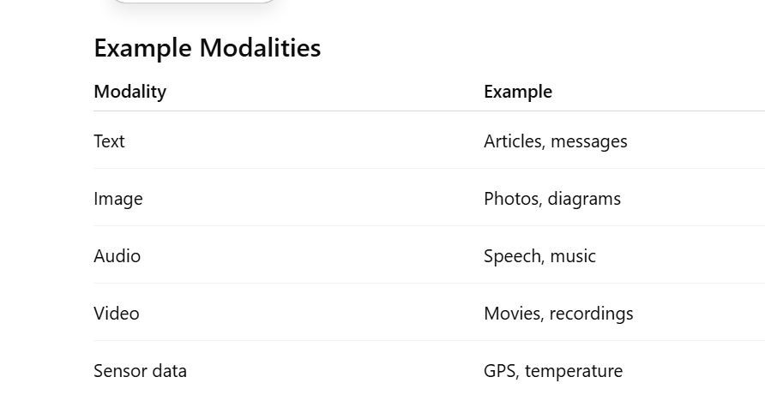
1.1.1 - Multimodal models

Slide 78
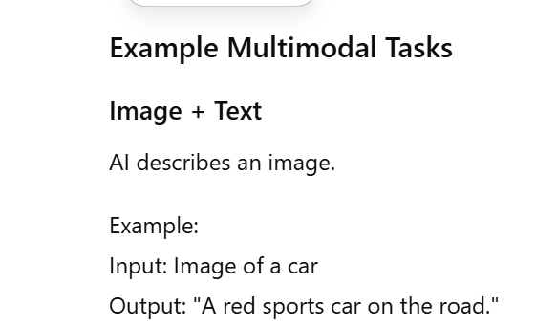
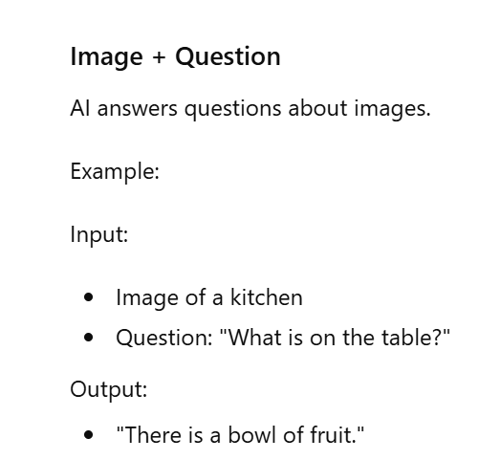
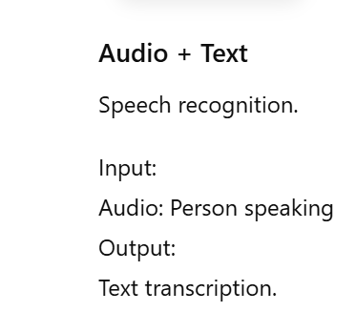
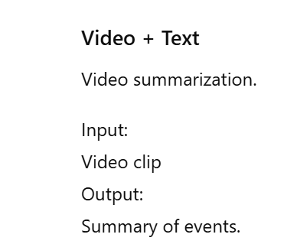
1.1.1 - Multimodal models

Slide 79
1.1.1 - Multimodal models
Examples of Multimodal AI Systems
GPT-4 Vision
Google Gemini
OpenAI DALL·E
Stable Diffusion
CLIP (Contrastive Language–Image Pretraining)
These models can understand text and images together.

Slide 80
1.1.1 - Applications of Multimodal AI
Healthcare
Analyze medical images and patient reports together.
Autonomous Vehicles
Combine camera images, radar, and sensor data.
Chatbots
Understand images and text together.
Software Testing
Multimodal AI can help testers:
Generate test cases from UI screenshots
Analyze application screenshots
Detect UI defects

Slide 81
1.1.1 - Applications of Multimodal AI
In software testing,
LLMs can support tasks such as
Reviewing and improving acceptance criteria
Generating test cases or test scripts
Identifying potential defects
Analyzing defect patterns
Generating synthetic test data
Supporting documentation generation, across the entire test process.

Slide 82
1.1.1 - Applications of Multimodal AI
Example in Software Testing
Input: Screenshot of login page
Prompt: "Generate test cases for this login UI."
Output: AI generates test cases such as:
Valid login
Invalid password
Empty username
Password length validation

Slide 83
1.1.1 - Applications of Multimodal AI
Challenges of Multimodal Models
High computational cost
Complex training
Large datasets required
Alignment between modalities is difficult

Slide 84
1.1.2- Basics of Generative AI and LLM’s
LLMs are trained on very large datasets, including books, articles, and websites.
LLMs (Large Language Models) are a type of Artificial Intelligence model designed to understand and generate human language.
They are called “large” because they are trained on very large datasets (billions or trillions of words) and contain millions or billions of parameters that help the model understand language patterns.
LLMs are the technology behind modern AI chatbots like ChatGPT, Gemini, and Claude.

Slide 85
1.1.2- Basics of Generative AI and LLM’s
These models can:
Answer questions
Write essays or summaries
Generate computer code
Translate languages
Hold conversations with users
Large
The model is very big in terms of:
Training data (books, websites, articles, code)
Number of parameters (internal mathematical weights)
Some modern LLMs are trained on trillions of words.
Model
A model is a mathematical system trained to predict patterns in data.
In LLMs, the model predicts the most likely next word in a sentence.
Example:
Input:
Artificial Intelligence is
The model predicts:
changing the world.
Language
They work with human language, such as:
English
Hindi
Spanish
Programming languages like Python or Java
They understand and generate text-based information.

Slide 86
1.1.2- Basics of Generative AI and LLM’s
Types of Language Models
LLM’s and SLM’s
LLM’s - Based on the generative pre-trained transformer deep learning model, LLM’s are trained on very large datasets, including books, articles, and websites
LLM’s can handle language nuances as well as generate coherent content.
Small language models (SLMs) are compact models with fewer parameters compared to large language models
Designed to provide lightweight and focused GenAI solutions

Slide 87
1.1.2- Basics of Generative AI and LLM’s
Examples of LLMs and SLMs
LLMs
GPT Series
LLaMA
Claude
Gemini
SLMs
Phi models
DistilBERT
TinyLLaMA
Mobile AI models – Gemma , MiniLM

Slide 88
1.1.2- Basics of Generative AI and LLM’s
How LLM.s process and Generate Content
Tokenization
Embedding
Transformer Architecture

Slide 89
1.1.2- Basics of Generative AI and LLM’s
How LLM.s process and Generate Content
Tokenization
Tokenization in language models is the process of breaking down text into smaller units called tokens.
Tokens can be as small as a character or as large as a sub-word or word.
When an LLM processes a sentence, it first tokenizes the input so that each token can be understood individually, while maintaining the overall context
Embeddings
Embeddings are numerical representations of tokens that encode their semantic, syntactic, and contextual relationships in a format suitable for processing by generative AI models
Each token is transformed into a vector in a high-dimensional space, capturing nuanced information about its meaning and usage.
Tokens with similar meanings or contextual roles have embeddings that are positioned closely together in this space.
This proximity enables LLMs to understand word relationships, retain context, and generate coherent and contextually appropriate responses.

Slide 90
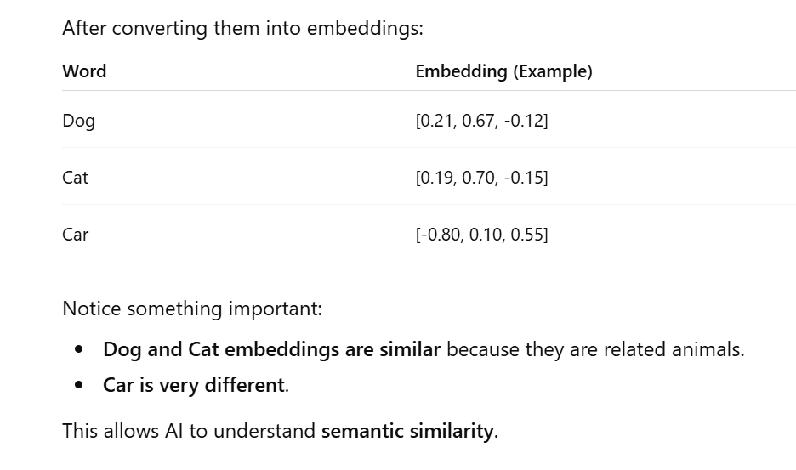
1.1.2- Basics of Generative AI and LLM’s
Why Embeddings Are Needed
Computers process data mathematically, but text is made of words and sentences.
So the system converts text like:
dog
into a vector of numbers such as:
[0.21, -0.45, 0.88, 0.12]
This numeric representation is called an embedding.
Simple Example
Suppose we have three words:
Dog
Cat
Car
After converting them into embeddings:

Slide 91
1.1.2- Basics of Generative AI and LLM’s
Transformer Architecture
LLMs utilize a neural network architecture known as the transformer model.
Transformer models excel in language tasks by processing the context of extensive text sequences and learning how tokens relate to each other.
LLMs predict the next token in a sequence, leveraging these learned relationships to generate coherent and contextually appropriate text.
The transformer model can be used to generate new text that is statistically plausible, based on training data and the prompt.

Slide 92
1.1.2- Basics of Generative AI and LLM’s
Key Behavior of LLM’s
Non-deterministic behavior
Primarily due to the probabilistic nature of their inference mechanisms and hyper-parameter settings.
This inherent randomness can lead to variations in outputs even when the same input is provided multiple times.
Same input may give different answers due to randomness
For example, if you prompt “What is AI”, you could get different answers every time for the same question
Context window
A larger context window allows the model to maintain coherence over longer passages, for example when analyzing large test logs.
Defines how much text the model can “remember”
Larger window = better coherence in long passages (eg analyzing the logs)
However, increasing the number of tokens in the context window also increases the computational complexity and processing time required for the model to perform effectively.
Trade off of larger windows is that it uses more tokens which increases the computation cost

Slide 93
1.1.2- Basics of Generative AI and LLM’s
Hands-On Objective HO-1.1.2 (H1): Practice Tokenization and Token Count Evaluation
This hands-on activity is designed to help trainees develop a practical understanding of tokenization and
its implications when working with LLMs. The exercise is divided into two key parts:
Tokenization: Use a tokenizer to break down a sample text into individual tokens. Examine the
output to see how words, punctuation, and phrases are represented, and identify patterns or
nuances in tokenization.
Token Count Evaluation: Measure the number of tokens generated from various input texts.
Analyze how token count influences model performance, particularly in relation to the model's
context window limits and efficiency considerations.
By the end of this exercise, trainees will be able to better anticipate how different text structures and
input lengths can affect interactions with LLMs.

Slide 94
1.1.2- Basics of Generative AI and LLM’s
Copilot link
https://copilot.microsoft.com/
Tokenizer
https://platform.openai.com/tokenizer
Models
https://developers.openai.com/api/docs/models
Embeddings demo
https://huggingface.co/spaces/hesamation/primer-llm-embedding?section=embeddings_as_graphs:_a_network_analysis

Slide 95
1.1.3 Foundation, Instruction-Tuned and Reasoning LLMs
Large Language Models are developed through progressively specialized training stages to enhance their effectiveness across a wide range of tasks.
These stages give rise to three main categories:
1.Foundation LLMs
2.Instruction-tuned LLMs
3.Reasoning LLMs.

Slide 96
1.1.3 Foundation LLMs
Foundation LLMs
These are general-purpose models trained on vast datasets (text, code, images)
Support various tasks across domains such as natural language processing, computer vision, and speech recognition.
Need adaptation to meet specific task requirements.
Examples of tasks they can perform:
Text generation
Question answering
Code generation
Summarization
Translation
Chatbots
Test case generation

Slide 97
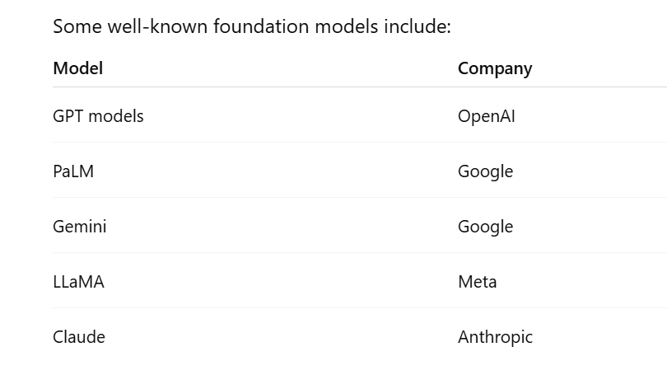
1.1.3 Foundation LLM’s
Foundation LLMs

Slide 98
1.1.3 Foundation LLM’s
Foundation LLMs

Slide 99
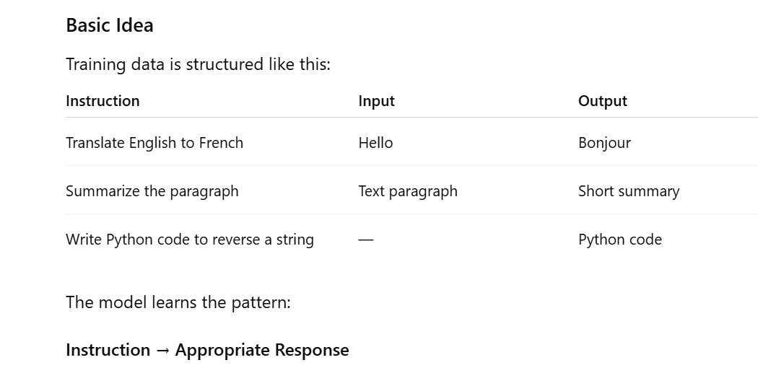
1.1.3 Instruction-Tuned
Instruction-Tuned
Derived from foundation models, instruction-tuned LLMs are fine-tuned using datasets that pair prompts with expected responses.
Better at following human instructions (For example , when asked to “Summarize the bug report” it gives a clear structured answer)
The tuning process involves optimizing for task adherence, instruction following, and response coherence, thereby improving the model's ability to interpret and act on user intent effectively

Slide 100
1.1.3 Instruction-Tuned
Instruction-Tuned
Derived from foundation models, instruction-tuned LLMs are fine-tuned using datasets that pair prompts with expected responses.
Better at following human instructions (For example , when asked to “Summarize the bug report” it gives a clear structured answer)
The tuning process involves optimizing for task adherence, instruction following, and response coherence, thereby improving the model's ability to interpret and act on user intent effectively

Slide 101
1.1.3 Instruction-Tuned
Instruction-Tuned
Examples of Instruction-Tuned Models
Some well-known instruction-tuned models include:
FLAN-T5
GPT-3.5 / GPT-4
InstructGPT
LLaMA-2 Chat
Alpaca
Vicuna

Slide 102
1.1.3 Reasoning LLMs
Reasoning models extend instruction-tuned models by emphasizing structured cognitive abilities such as logical inference, multi-step problem-solving, and chain-of-thought reasoning.
These models are further trained or fine-tuned on carefully selected tasks that demand contextual understanding, intermediate reasoning steps, and synthesis of complex information.
As a result, they are better suited for high-cognitive-load tasks, including those in technical domains.
It can handle complex, technical tasks.
In simple words
Reasoning LLMs are a type of Large Language Model designed to analyze problems, think through steps, and produce logical solutions rather than just generating text based on patterns.
Example :
If a train travels 60 km in 1 hour, how far will it travel in 3 hours?
A reasoning model will process it logically:
Speed = 60 km/hour
Time = 3 hours
Distance = Speed × Time
Distance = 60 × 3 = 180 km
Answer: 180 km

Slide 103
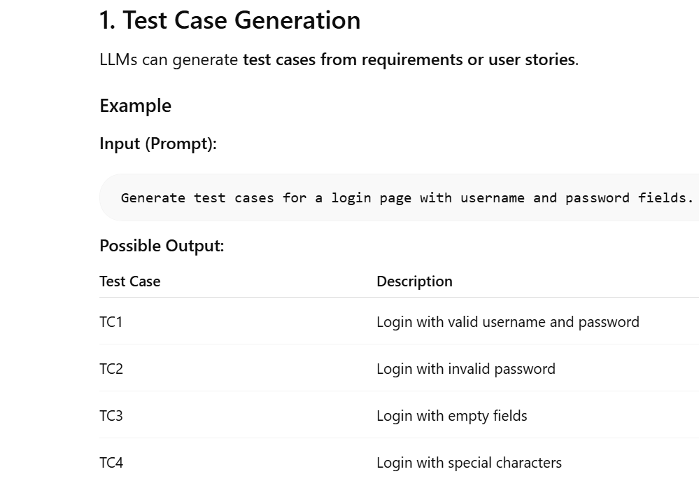
1.1.3 Application in software testing
In the context of GenAI applications for software testing, both instruction-tuned (sometimes referred to as non-reasoning) and reasoning LLMs are utilized.
Instruction-tuned LLMs are (non reasoning) are good for simple tasks like summarizing defects or generating testcases
reasoning LLMs are good for complex tasks multi step logic (eg analyzing long test logs)
Instruction-Tuned Example

Slide 104
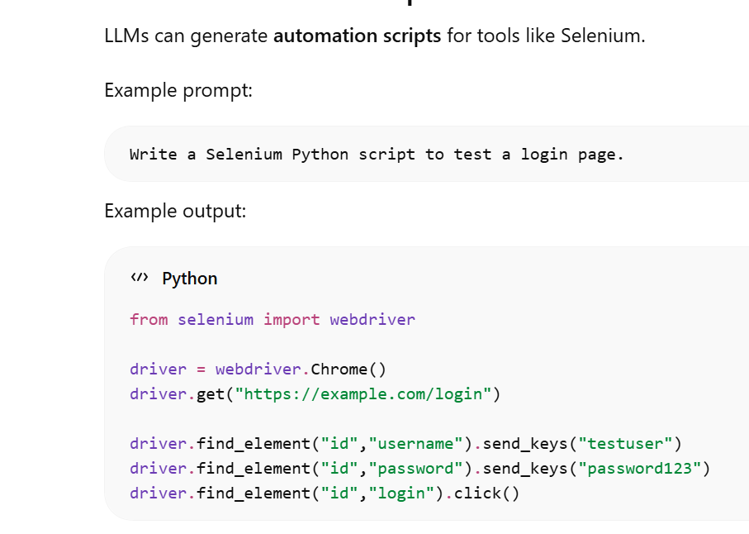
1.1.3 Application in software testing
Instruction-Tuned Example

Slide 105
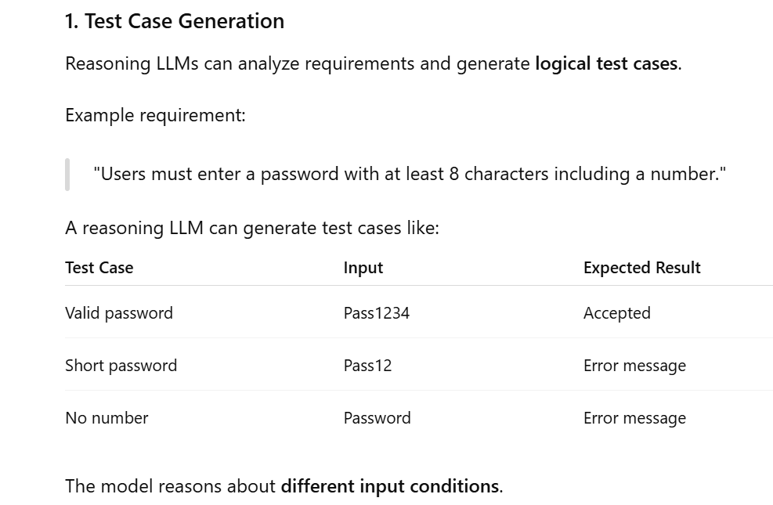
1.1.3 Application in software testing
Reasoning LLMs example

Slide 106
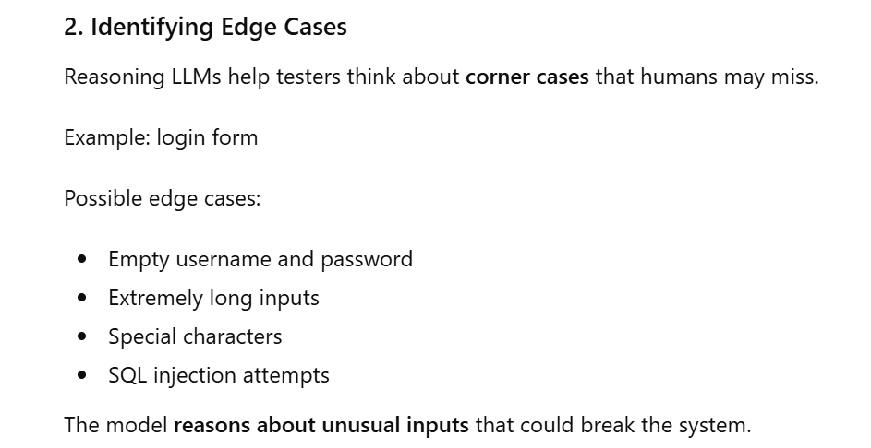
1.1.3 Application in software testing
Reasoning LLMs example

Slide 107
1.1.4 Multimodal LLMs and Vision-Language Models
Multimodal LLMs are the AI models than can handle different types of data like
Text
Images
Sound
Video
These models are trained on large and diverse datasets that enable them to learn relationships between different types of data
Each data is converted into tokens / embeddings before processing

Slide 108
1.1.4 Vision-Language Models
Vision-language models, a subset of multimodal LLMs
Integrate visual and textual information to perform tasks such as image captioning, visual question answering and analyzing the consistency between textual and visual input.
Few common tasks:
Image captioning (describe what's in a picture)
Visual question answering (answer the question about an image)
Check the consistency between text and visuals

Slide 109
1.1.4 Vision-Language Models
Uses of these models on software testing
Analyse screenshots, GUIs, wireframes ,defect reports ,user stories
This capability allows testers to identify discrepancies between expected results and actual visual elements on a screenshot.
LLMs augmented with vision-language models can generate rich, realistic test cases that incorporate both textual data and visual cues, thereby increasing overall coverage.
For example :
If the text in the requirement says “Button should be green ” and the screenshot shows red then
The model flags the defect automatically

Slide 110
1.1.4 Hands-On Objective HO-1.1.4 (H1) you need to check this
Hands-On Objective HO-1.1.4 (H1): Review and execute a given prompt addressing a test task using a multimodal LLM model
This exercise involves reviewing and executing a given prompt for a multimodal LLM using both text and image input to solve a test task in two steps:
• Review the inputs: Review the prompt and the input data (text and image).
• Execute the prompt and verify the result: Use a multimodal LLM to input both image and text and check the LLM's response.
This exercise demonstrates how to use multimodal LLMs for a task involving both text and image input in software testing use cases, including recognizing the benefits and potential challenges involved.

Slide 111
Thank You – We are done with 1.1 module

Slide 112
1.2- Leveraging Generative AI in Software Testing: Core Principles
GenAI provides transformative capabilities in various test activities
Some capabilities of LLMs that are helpful in software testing are
Processing the natural language code
generating coherent text and code,
answering questions,
summarizing information, translating languages
analyzing images in a multimodal context.

Slide 113
1.2- Leveraging Generative AI in Software Testing: Core Principles
1.2.1 Key LLM Capabilities for Test Tasks
Requirements analysis and improvement: LLMs can help analyze requirements, and other elements of the test basis, by identifying ambiguities, inconsistencies, or missing information. They can generate meaningful questions to help clarify requirements during discussions with stakeholders
Test case creation support: LLMs can help generate test cases and suggest test objectives based on system requirements, user stories or any other elements of the test basis
Test oracle generation: LLMs can help generate expected results.
Test data generation: LLMs can generate datasets, set boundary values, and create different combinations of test data.
Test automation support: LLMs can help generate test scripts from test case description and improve existing test scripts by suggesting changes and identifying appropriate test design techniques.
Test result analysis: LLMs can help analyze test results by creating summaries and classifying anomalies based on severity and priority.
Test ware creation: LLMs can help create various documents, including test plans, test reports and defect reports, and keep them updated as the project evolves.

Slide 114
1.2- Leveraging Generative AI in Software Testing: Core Principles
1.2.2 AI Chatbots and LLM-Powered Testing Applications for Software Testing
AI chatbots are computer programs that use Artificial Intelligence (AI) to simulate human-like conversations with users through text or voice
AI Chatbots provide a user-friendly, conversational interface that enables testers to communicate directly with LLMs.
Unlike simple scripted bots, AI chatbots use technologies such as Natural Language Processing (NLP) and Large Language Models (LLMs) to understand natural language and respond intelligently.
Testers can input questions, commands or prompts and receive immediate, contextually aware responses
Testers can use techniques such as prompt chaining to refine outputs, making chatbots particularly effective for
Exploratory testing
Routine tasks
onboarding new testers by providing quick access to testing knowledge and practices
Benefits
Fast feedback and clarification
Easy to use (even non technical stakeholders can be benefited

Slide 115
1.2- Leveraging Generative AI in Software Testing: Core Principles
1.2.2 AI Chatbots and LLM-Powered Testing Applications for Software Testing
Examples of AI chat bots
ChatGPT – An AI chatbot by OpenAI that answers questions and assists with writing, coding, and learning.
Google Gemini – Google’s AI chatbot that helps with research, productivity, and problem-solving.
Microsoft Copilot – An AI assistant integrated with Microsoft tools like Word, Excel, and Edge.
Claude – An AI chatbot developed by Anthropic known for reasoning and document analysis.
IBM Watson Assistant – An enterprise AI chatbot used for customer service automation.

Slide 116
1.2- Leveraging Generative AI in Software Testing: Core Principles
1.2.2 AI Chatbots and LLM-Powered Testing Applications for Software Testing
LLM-Powered Testing Applications
LLM powered Testing applications are the LLMs integrated into test tools via APIS
They perform automated well defined tasks inside the frameworks
LLM-Powered Testing Applications are software testing tools or systems that use Large Language Models (LLMs) to assist or automate different activities in the software testing lifecycle.
Key features
Customization and scalability allowing organizations and tool vendors to embed generative AI into existing test frameworks
Automation of repetitive or complex tasks, such as test case generation, defect analysis, or test data synthesis
AI agents specifically designed to perform certain testing roles
Example : (LLM powered test automation tool automatically generates selenium scripts from the user stories)

Slide 117
1.2- Leveraging Generative AI in Software Testing: Core Principles
1.2.2 AI Chatbots and LLM-Powered Testing Applications for Software Testing
LLM-Powered Testing Applications
Examples of LLM-Powered Testing Tools
Some modern tools integrating LLM capabilities include:
Testim
Functionize
Mabl
Katalon Studio
These tools use AI to assist in test creation, execution, and maintenance.

Slide 118
1.2- Leveraging Generative AI in Software Testing: Core Principles
1.2.2 AI Chatbots and LLM-Powered Testing Applications for Software Testing
Factors for successful Implementation of Generative AI in testing
Successful implementation of generative AI in testing requires strong prompt engineering
Clear, specific instructions are essential to ensure that LLM-generated outputs are accurate, relevant, and aligned with testing objectives
Example prompts:
Vague prompts – “Test login” (you will get unclear output)
Clear prompts – “Generate 5 testcases for login with valid/invalid credentials” (you will get better result )

Slide 119
Thank You – We are done with 1.2 module

